Slide 1

ANALYSIS ON FOOD CHOICE BASED ON DIFFERENT FACTORS

Slide 2
INTRODUCTION
The choice of food is a fundamental aspect of human life, as it affects not only our physical health but also our social and cultural identities. The decision-making process behind food choices is influenced by various factors, including personal preferences, nutritional needs, cultural traditions, cost ,time,availability, affordability, and environmental concerns. Understanding the dynamics of food choice is crucial for promoting healthy eating habits and sustainable food systems. In this analysis, we will explore the different factors that influence food choices.

Slide 3
TARGET GROUP AND TOOLS USED
Age Group: Every age group
Tools used : Python and Excel

Slide 4
SURVEY RESPONSES

Slide 5
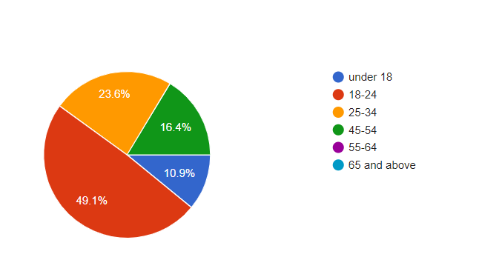
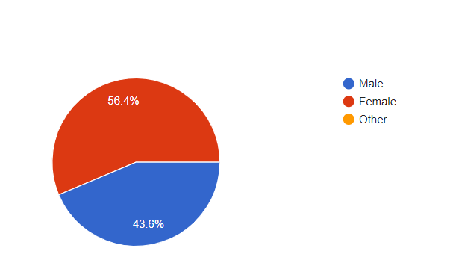
AGE
GENDER

Slide 6
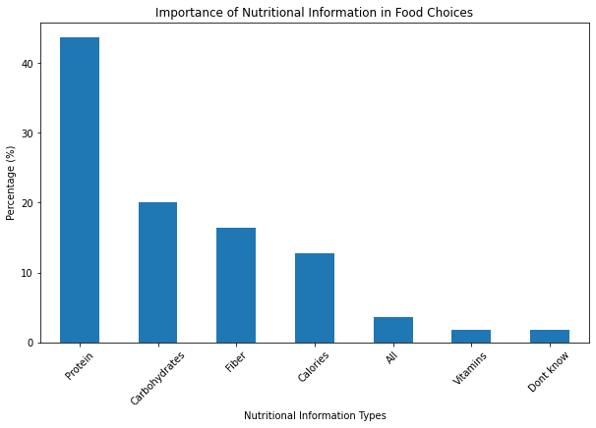

Slide 7
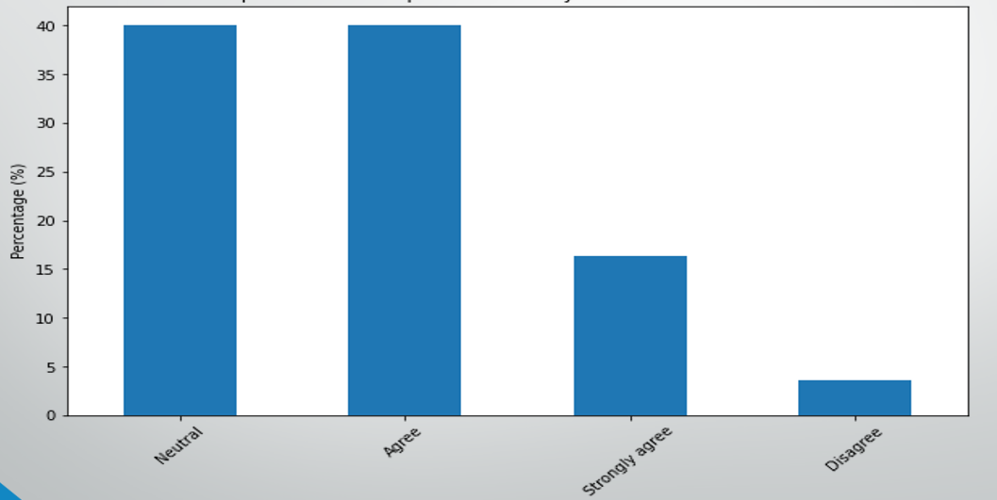
Time is a factor for choosing food

Slide 8
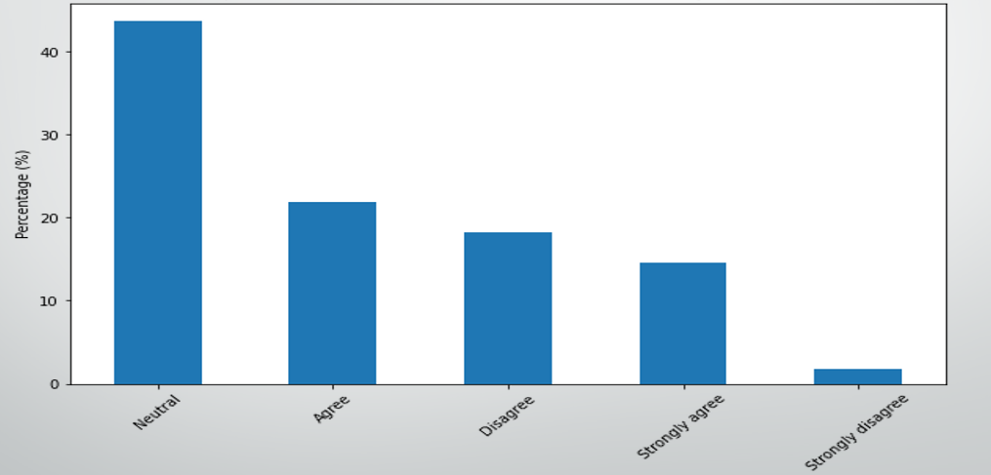
Cost is a factor for choosing food

Slide 9
EXPECTED OUTCOME:
To analyse the relationship between nutrition and food choice.
To analyse the relationship between time and food choice.
To analyse the relationship between cost and food choice.

Slide 10
ANALYSIS OF THE STUDY

Slide 11
Analysing the relationship between nutrition and food choice.
Null hypothesis: There is no significant association between the choice of nutritional information and the type of food chosen.
Alternative hypothesis: There is significant association between the choice of nutritional information and the type of food chosen.
Calculations:
Chi-Square Statistic: 3.9115897652483036
P-value : 0.41810308077807967
Degrees of Freedom : 4
Critical value : 9.488
Conclusion :
The test result is not statistically significant,failing to reject the null hypothesis

Slide 12
Analysing the relationship between time consumption and food choice.
Null hypothesis: There is no significant association between the time consumption and food choice.
Alternative hypothesis: There is significant association between the time consumption and food choice.
Calculations:
Chi-Square Statistic: 0.3725984939430316
P-value : 0.8300251752943782
Degrees of Freedom : 2
Critical value : 5.991
Conclusion :
The test result is not statistically significant,failing to reject the null hypothesis

Slide 13
Analysing the relationship between cost and food choice.
Null hypothesis: There is no significant association between cost and food choice.
Alternative hypothesis: There is significant association between cost and food choice.
Calculations:
Chi-Square Statistic: 0.934831226920476
P-value : 0.6266196047432712
Degrees of Freedom : 2
Critical value : 5.991
Conclusion :
The test result is not statistically significant,failing to reject the null hypothesis

Slide 14
CONCLUSION

Slide 15
CONCLUSION
There is no significant association between nutritional content and food choice.
There is no significant association between time and food choice.
There is no significant association between cost and food choice.

Slide 16
DONE BY
KRISHNAPRIYA .K.J
GEENA .P. GEORGE
SHERLIN DAISON

